Slide 1
What Should We Pay for a Full-Time Data Scientist?
Merrimack College
DSE5002 – 10/2/2026
Professor: Dr. Wifvat
Presented by: Andrey Marchenko

Slide 2
What This Data Can & Can’t Tell Us
Dataset comprised of 2020-2022 years only (not current information)
Experience level is not quantified by years of experience
Limited small company data with only 2 Sr. Data Scientists to work from
Offshore = anyone whose listed residence is outside the United States
Recommendations come from US, full-time Sr. Data Scientists specifically
These limitations don’t invalidate the analysis, but provide a starting point instead of current market data

Slide 3
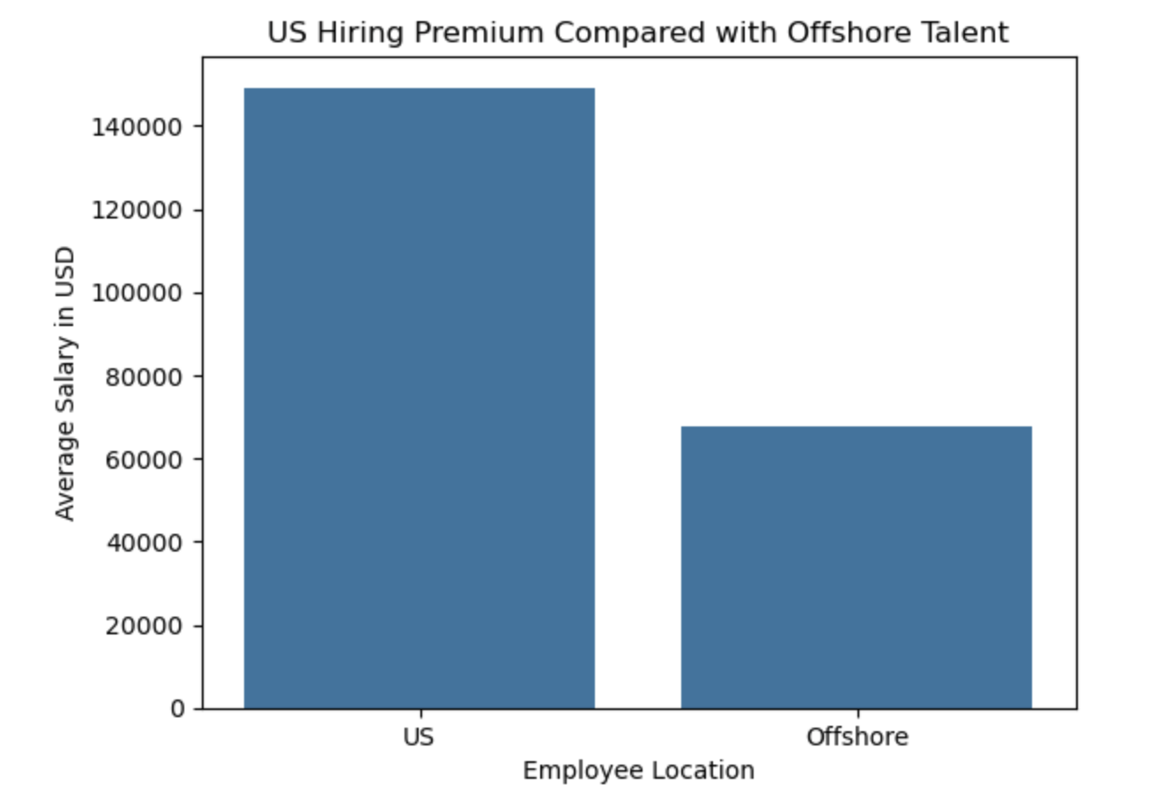
Hiring in the US Costs More
Average US Salary = $149,000
Average Offshore Salary = $68,000
Difference of two groups = $81,000
US market pays more than double for similar role types
Analysis assumes we hire from US only

Slide 4
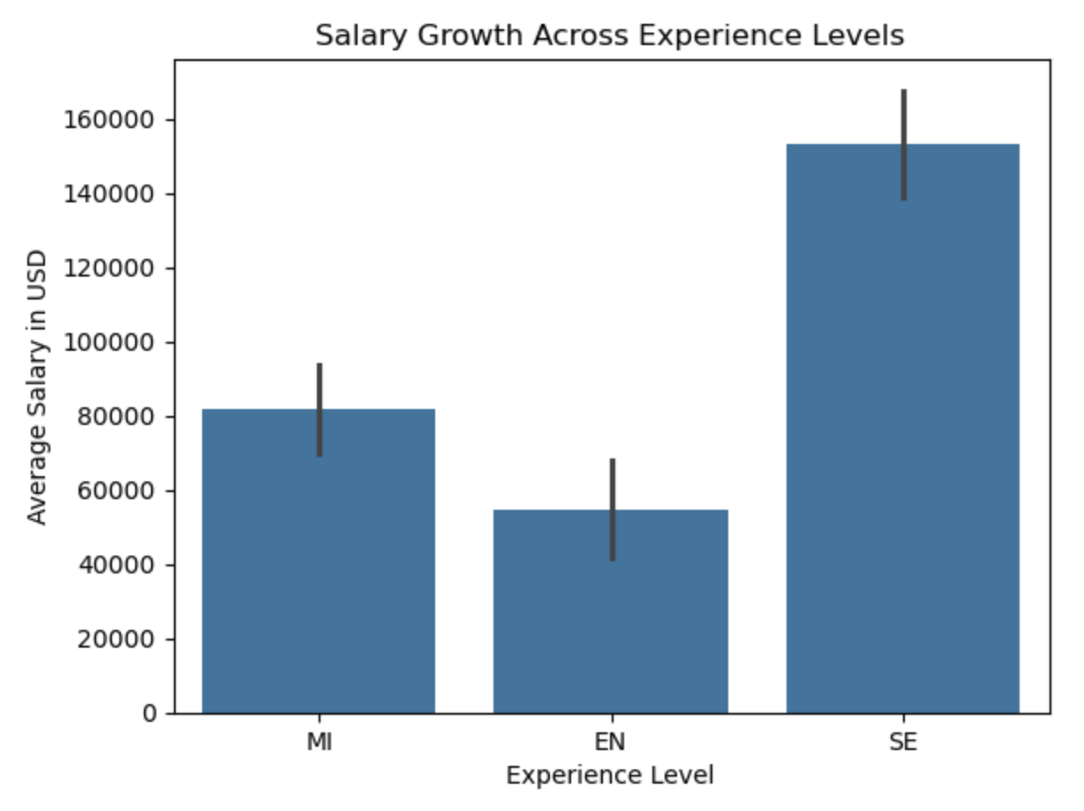
Salary Nearly Triples at the Senior Level
Entry level roles pay $55,000
Mid level pays $82,000
Senior level pays $153,000
The role we’re filling is designed to help manage a data science team
If pricing this job against Mid level, we would be $70k short of what comparable data scientists earn
Senior level is the comparison I’ve used for the rest of analysis

Slide 5
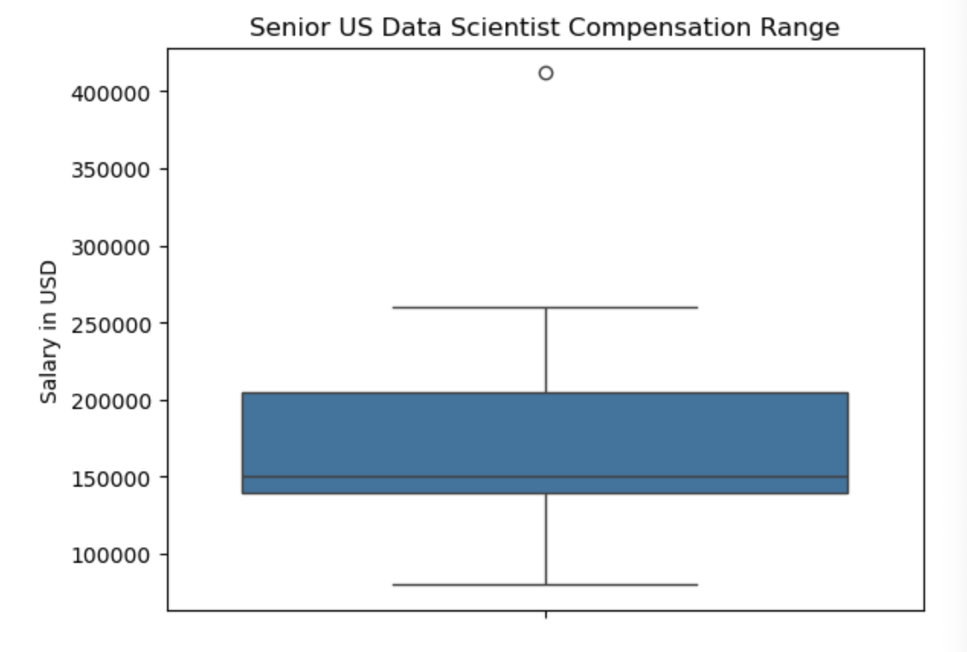
Senior US Salary Range
Median Sr. role pays $150,000
Average Sr. role pays $167,000
75th Percentile pays $205,000
More than half of Senior hires earn above $150k. An offer at the median may not be competitive enough
The 75th percentile at $205K is a useful ceiling, and going above this point will be difficult to justify ($405k)

Slide 6
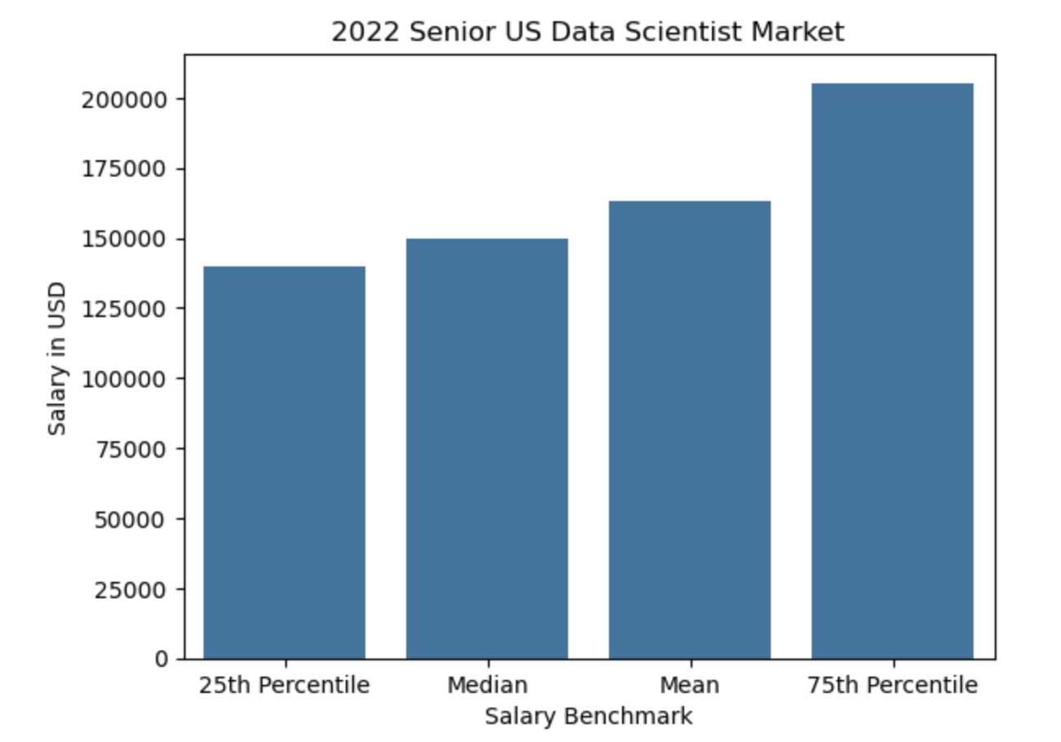
Recommended Salary Offer
Recommended target offer:
$160-190k
Broader market range is $150-205k
Offering above $150k should make us more competitive
If we want to have somebody with a lot of technical and leadership experience, we have room to grow from $190k toward $205k

